Slide 2
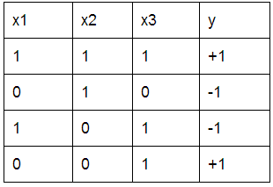
Let us train T1, a decision tree, with the data given below. Which feature will you split at the root?
1
x1
x2
x3
y

Slide 3
Let us train T1, a decision tree, with the data given below. Which feature will you split at the root?
1
x1
x2
x3
y
C
x3 will split because it has the lowest classification error. At row 3, x3=1, y=-1; there is only one error compared to other features.

Slide 4
If you are training a decision tree, and you are at a node in which all of its data has the same y value, you should:
2
Find the best feature to split
Create a leaf that predicts the y value of all the data
Terminate recursions on all branches and return the current tree
Go back to the parent node and select a different feature to split so that the y values are not all the same at this node

Slide 5
If you are training a decision tree, and you are at a node in which all of its data has the same y value, you should:
2
Find the best feature to split
Create a leaf that predicts the y value of all the data
Terminate recursions on all branches and return the current tree
Go back to the parent node and select a different feature to split so that the y values are not all the same at this node
B
You should create a leaf that predicts the y value of all the data.

